Slide 1
Basics of Python

Slide 2
Agenda
Why Python?
Variables and data types
Python collections
Loops
Functions
File handling
Libraries: NumPy, Pandas

Slide 3
Why Python?
Multipurpose Language
Data science / Machine Learning
Web development
Windows desktop applications

Slide 4
Hello World
IDE: Spyder/PyCharm
Creating new Python program
Hello World

Slide 5
Variables and Data types
Declaration: Specifying data type not required. E.g. num1 = 4
Data type is auto-assigned based on value assigned.
Re-assign different value to the variable to change the datatype. E.g. num1 = “abc” will change datatype to ‘string’.

Slide 6
Variables and Data types: Hands-on
Create two variables firstNumber = 20 and secondNumber = 30.
Add them and store the value in a new variable ‘sum’.
Print ‘sum’.
Print type of ‘sum’.
Re-assign sum to string “fifty”.
Print type of ‘sum’.

Slide 7
Variables and Data types: Playing with strings
Always declare a string using “double quotes”.
String concatenation: Two strings can be concatenated by using ‘+’ in-between.

Slide 8
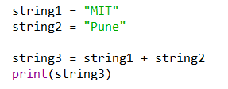
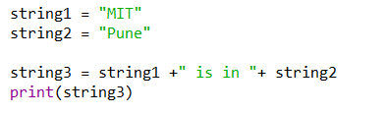
Answer this!
Find output of following code:

Slide 9

Answer this!
Find output of following code:

Slide 10
Variables: Accepting input
Use function input() for Python version 3.x. Use raw_input() for Python version 2.x.
E.g. myNum = input(“Enter my Number: “)
Default data type of input() will be always string.
How to deal with other data types?

Slide 11
Collections (List)
List: Sequence data type
Defining list: list1 = [2, 4, 7]
Adding element to list: list1.append(8)
Indexes of list start from 0.
Accessing elements: list1[2].
Slice: list1[2:4]

Slide 12
Collections (List): Deletion
1st method: del list1[1]
This will delete element at position 1 in the list. This brings further elements 1 position left. This can be used to delete range of elements too.
2nd method: list1.remove(4)
This will delete first occurrence of ‘4’ from the list. This searches for the value and not for the index.

Slide 13
Collections (List): Deletion
3rd method: list1.pop()
Deletes the rightmost element.
4th method: list1.pop(3)
Searches for index = 3 and deletes that element.

Slide 14
Lists: Hands on
Create a list years = [2015, 2017, 2019]
Add an element 2021 to the list using append() method.
Print whole list
Print element at the 2nd position of the list.
Delete element at the 1st position of the list.
Print whole list.

Slide 15
Explore lists!
Addition: append(), insert(), extend()
Searching: index()
sort()
reverse()

Slide 16
Collections (Tuples)
Tuples: Sequence data types
Defining tuple: T1 = (1,2,3,4)
Defining empty tuple: T1 = ()
Indexing, accessing data is similar to Lists.
Deleting tuple: del T1
Individual element can’t be deleted from a tuple.

Slide 17
What’s the difference between List and Tuple?
List | Tuple
1. Mutable (Can be modified) | 1. Immutable (Can’t be modified)
2. Can have different type of data. e.g. list1 = [2, 4, “abc”, 3.6, 9, “xyz”] | 2. Tuple can’t have heterogeneous data.

Slide 18
Collections (Sets)
Set: Collection data type
Set can’t have duplicate values unlike list and tuple.
Defining set: S1 = {15, 17, 13}

Slide 19
Explore sets!
clear()
add()
remove()
S1.difference(S2)
issubset(), issuperset()
intersection()

Slide 20
Collections (Dictionary)
Dictionary: Key-Value pair data type
Defining a dictionary: dict1 = {1:”A”, 2:”B”, 3:”C”}
Accessing using key: dict1[2] returns “B”.
Delete a pair: del dict1[key]

Slide 21
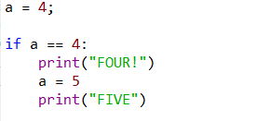
Using if/else
No parenthesis, no curly brackets!
Indentation defines scope.
E.g.

Slide 22
Using if/else: Hands-on
Accept integer input from user and save it into variable ‘year’.
If the year is 2018, print ‘This year’. If the year is less than 2018, print ‘Past’, and if it is greater than 2018, print ‘Future’.
HINT: Make use of elif.

Slide 23
Loops: for
To traverse (typically) through a collection.

Slide 24
For loop: Hands on
Create a hard-coded list of numbers.
Traverse this list using for loop.
Print every number and ‘Even’ or ‘Odd’ in-front of it.
HINT: Use comma to separate string and variable in print statement.

Slide 25
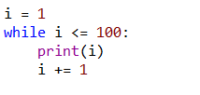
Loops: while
Used to iterate till the condition holds true.

Slide 26
While loop: Hands on
Print all even numbers starting from 1 to 100.

Slide 27
Python doesn’t has ‘do-while’ loop!

Slide 28

Functions
Creating a function:

Slide 29
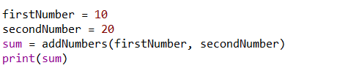
Functions
Calling a function:

Slide 30
Functions: Hands on
Write a function to return “Hi!! This is name; and I'm age years old.”, where ‘name’ is a string and ‘age’ an integer passed as parameter to the function.

Slide 31
File handling
Opening a file: F1 = open(“path to file”, ‘opening mode’)
Opening modes: r – read w – write a – append

Slide 32
File handling
Closing a file: F1.close()

Slide 33
File handling: Read contents
Open file with read mode (‘r’).
Store contents of the file in a variable using read() function. contents = f1.read()
This variable can be accessed as a string variable.

Slide 34
File handling: Write contents
Open file with write mode (‘w’).
Write text using write() function. F1.write(“This is text”)
Write mode replaces the whole text originally present (if any) in the file with the new text.
Write mode creates a new file if the file is not present already.

Slide 35
File handling: Append content
Open file with append mode.
Write content similar to ‘write’ mode.
Text will get added to the previously existing text.
You cannot read contents in ‘w’ or ‘a’ mode.

Slide 36
DO NOT forget to close the file!

Slide 37
Python libraries
NumPy
Pandas
scikit-learn
matplotlib
And many many more…

Slide 38
Installing Python libraries
pip install numpy
Refer ‘PyPI’ for information regarding libraries.

Slide 39
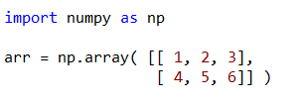
NumPy
Multi-dimensional arrays: NumPy offers functionality for ndarrays.
Defining an array:

Slide 40
NumPy: Working on n-D arrays
Indexing starts from 0.
Accessing elements: arr[1,2]
Explore functions like: reshape(), flatten(), sin(), sqrt(), sort()

Slide 41
Pandas
Pandas has various data structures, which are built over numPy arrays.
Data structures: Series (1D), DataFrame (2D), Panel (3D)

Slide 42
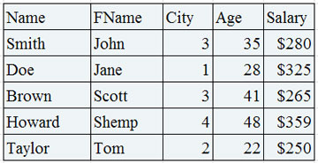
Pandas: DataFrame
DataFrame is a frame of database!

Slide 43
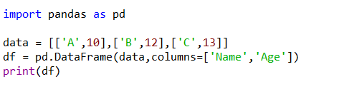

Pandas: DataFrame
DataFrame contains heterogeneous 2D data.
Creating a DataFrame from list of lists

Slide 44
Pandas: DataFrame
Use read_sql(“query”) or read_sql_query(“query”) function to access SQL table into Python code.
Used to access data from DB.

Slide 45
Summary
Why Python?
Variables and data types
Python collections
Loops
Functions
File handling
Libraries: NumPy, Pandas

Slide 46
Resources to study
GeeksForGeeks, TutorialsPoint, W3Schools
For libraries, use official documentation.

Slide 47
Thank You!

